Slide 1
Normal Distribution Part 3
Normality tests
Introduction to hypothesis testing

Slide 2
How do we test for normality of data?
In statistics, normality tests are used to determine if a data set is well-modeled by a normal distribution

Slide 3
Step one: Histogram
z cores- and evaluate the 68 -95-99.7 % rule
Box plot (5 number statistics; mild and extreme outliers)
Normal quantile plot
Also called quantile-quantile or Q-Q plot
Shapiro – Wilk test
Kolmogorov-Smirnov Test

Slide 4
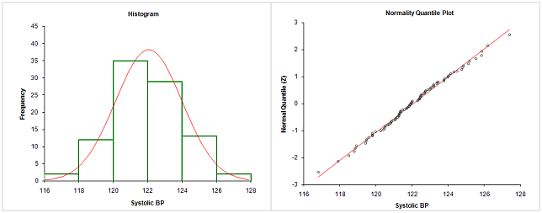
Step one: Histogram
z cores- and evaluate the 68 -95-99.7 % rule
Box plot (5 number statistics; mild and extreme outliers)
Normal quantile plot
Also called quantile-quantile or Q-Q plot

Slide 6
Definition of normal quantile plot
Graph of points (x,y) where each y value is from the original set of sample data and each x value is the corresponding z score that is a quantile value expected from a normal distribution
Quantiles are points taken at regular intervals from the cumulative distribution function (CDF) of a random variable.

Slide 7
Quantile plot procedure
Open .doc file in ecourseware
Open excel file : normal quantile plot worksheet

Slide 8
Procedure
Make a histogram
Reject normality if the histogram is not bell shaped.
Outliers
Identify outliers and reject normality if there is more than one outlier present
Make a quantile plot
Sort the data from lowest to highest
Rank the samples
Crate a rank proportion (Rank/N; (Rank-0.5)/N; Rank/(N+1)
Use the standard normal distribution to find the z scores corresponding to the rank proportion
Match the original sorted data with their corresponding z score
Graph the x values and the corresponding z values
If the line does not resemble a straight line, the data does not come from a normal distribution

Slide 9
Example:
Data Rank Rank Rank-based
Proportion z-scores
Normsinv(/N)
X(80.7) 1 1/N (1-0.5)/N 1/(N+1)
Y(56.3) 2 2/N (2-0.5)/N 2/(N+1)
Z(83.5) 3 3/N (3-0.5)/N 3/(N+1)
K(79.0) 4 4/N (4-0.5)/N 4/(N+1)
L(93.6) 5 5/N (5-0.5)/N 5/(N+1)
Probability
Heart rate BPM
Rank based z scores

Slide 10
Heart rate BPM
Rank based z scores

Slide 11
Time dependent frequency data of a QCM:
time | frequency | time | frequency | time | frequency | time | frequency | time | frequency
0.0 | 9998961.0 | 12.0 | 9998961.6 | 24.0 | 9998960.9 | 36.0 | 9998961.1 | 48.0 | 9998961.1
0.5 | 9998960.8 | 12.5 | 9998961.5 | 24.5 | 9998961.1 | 36.5 | 9998961.8 | 48.5 | 9998961.0
1.0 | 9998960.6 | 13.0 | 9998961.8 | 25.0 | 9998961.2 | 37.0 | 9998961.4 | 49.0 | 9998960.7
1.5 | 9998961.7 | 13.5 | 9998961.4 | 25.5 | 9998961.3 | 37.5 | 9998961.4 | 49.5 | 9998960.2
2.0 | 9998961.0 | 14.0 | 9998961.5 | 26.0 | 9998961.3 | 38.0 | 9998961.5 | 50.0 | 9998960.6
2.5 | 9998961.0 | 14.5 | 9998961.4 | 26.5 | 9998961.1 | 38.5 | 9998961.4 | 50.5 | 9998960.5
3.0 | 9998960.4 | 15.0 | 9998961.4 | 27.0 | 9998961.1 | 39.0 | 9998961.4 | 51.0 | 9998960.8
3.5 | 9998960.7 | 15.5 | 9998961.1 | 27.5 | 9998960.7 | 39.5 | 9998961.9 | 51.5 | 9998960.7
4.0 | 9998960.5 | 16.0 | 9998960.9 | 28.0 | 9998961.0 | 40.0 | 9998961.7 | 52.0 | 9998960.5
4.5 | 9998960.4 | 16.5 | 9998960.9 | 28.5 | 9998961.1 | 40.5 | 9998961.1 | 52.5 | 9998960.4
5.0 | 9998961.3 | 17.0 | 9998961.1 | 29.0 | 9998961.4 | 41.0 | 9998961.4 | 53.0 | 9998960.7
5.5 | 9998961.4 | 17.5 | 9998960.7 | 29.5 | 9998961.1 | 41.5 | 9998960.9 | 53.5 | 9998961.0
6.0 | 9998961.6 | 18.0 | 9998961.2 | 30.0 | 9998960.2 | 42.0 | 9998960.9 | 54.0 | 9998961.0
6.5 | 9998961.4 | 18.5 | 9998961.0 | 30.5 | 9998961.2 | 42.5 | 9998960.8 | 54.5 | 9998961.1
7.0 | 9998961.9 | 19.0 | 9998960.6 | 31.0 | 9998960.8 | 43.0 | 9998961.1 | 55.0 | 9998960.5
7.5 | 9998961.7 | 19.5 | 9998960.7 | 31.5 | 9998961.2 | 43.5 | 9998961.4 | 55.5 | 9998961.2
8.0 | 9998961.1 | 20.0 | 9998960.9 | 32.0 | 9998961.7 | 44.0 | 9998961.5 | 56.0 | 9998961.3
8.5 | 9998961.5 | 20.5 | 9998961.3 | 32.5 | 9998961.4 | 44.5 | 9998961.7 | 56.5 | 9998961.1
9.0 | 9998961.0 | 21.0 | 9998961.1 | 33.0 | 9998961.5 | 45.0 | 9998961.0 | 57.0 | 9998960.9
9.5 | 9998961.2 | 21.5 | 9998961.5 | 33.5 | 9998961.0 | 45.5 | 9998961.3 | 57.5 | 9998961.5
10.0 | 9998961.2 | 22.0 | 9998960.9 | 34.0 | 9998961.4 | 46.0 | 9998961.3 | 58.0 | 9998961.5
10.5 | 9998961.5 | 22.5 | 9998960.9 | 34.5 | 9998961.5 | 46.5 | 9998961.3 | 58.5 | 9998961.2
11.0 | 9998961.8 | 23.0 | 9998961.4 | 35.0 | 9998961.3 | 47.0 | 9998961.0 | 59.0 | 9998961.6
11.5 | 9998961.3 | 23.5 | 9998961.2 | 35.5 | 9998961.1 | 47.5 | 9998961.5 | 59.5 | 9998961.3

Slide 12
Time dependent data measured with a mass sensitive sensor called as the quartz crystal microbalance.
Min | 9998960.2
Max | 9998961.9
Mean | 9998961.2
Median | 9998961.2
STDEV | 0.37
120 points
7 categories
 | Hz | frequency
1 | 9998960.2 | 1
2 | 9998960.5 | 5
3 | 9998960.8 | 16
4 | 9998961.1 | 32
5 | 9998961.4 | 32
6 | 9998961.7 | 26
7 | 9998962.0 | 8

Slide 13
Q-Q representation of the QCM data

Slide 14
Time dependent data measured with a mass sensitive sensor called as the quartz crystal microbalance.
Min | 9998960.2 | 9998959.1
Max | 9998961.9 | 9998963.2
Mean | 9998961.2 | 9998961.2
Median | 9998961.2 | 9998961.2
STDEV | 0.37 | 0.92

Slide 15
Min | 9998960.2 | 9998960.5
Max | 9998961.9 | 9998964.6
Mean | 9998961.2 | 9998962.6
Median | 9998961.2 | 9998962.6
STDEV | 0.37 | 0.92

Slide 16
Min | 9998960.2 | 9998960.5
Max | 9998961.9 | 9998964.6
Mean | 9998961.2 | 9998962.6
Median | 9998961.2 | 9998962.6
STDEV | 0.37 | 0.92
Histogram of the yellow data set

Slide 17
Q-Q representation of the QCM data without and with time dependent drift

Slide 18
Linear regression – residual mean standard deviation (RMSD)
Are the data randomly distributed around the fitted line?

Slide 19
Are these data normally distributed around the mean?
To check whether the sampling can be considered random and normally distributed around the mean one should count how many data (k) are above or below the mean in a sequence. In a normally distributed data set one can tell the probability (P=α) of the appearance of a sequence length with k members in a set of data with N members.
k | α=0.01 | α=0.05 | α=0.1
3
4 |  | 7 | 11
5 | 9 | 26 | 48
6 | 34 | 153 | 309
7 | 234 | 1170 | 2396

Slide 20
Test of Normality:
The probability (α) that in a data set with N members one will not find a sequence (above or below the mean) with a length of k
k | α=0.01 | α=0.05 | α=0.1
2 | 12 | 8 | 7
3 | 61 | 40 | 32
4 | 321 | 210 | 162
5 | 1923 | 1253 | 964
Example:
(N=12): 4, 7, 4, 5, 1, 9, 4, 8, 1, 5, 2, 7 Mean: 4.75
Can not be considered as random, normally distributed statistical sample because in a sample of N=12 the probability that a sequence of k=2 (above or below the mean) does not appear is less than 1 %

Slide 21
Normal distribution assessment
Shapiro-Wilk Normality Test

Slide 22
Shapiro-Wilk Normality Test
Also known as the Shapiro-Wilk W test
Is an analysis of variance test that detects a broad range of different types of departure from normality in a sample of data
Generally agreed that it is highly reliable test for non-normality for small to medium sized samples
Please do not assume that the result of this test is clear evidence of normality or non-normality, it is just one piece of evidence that used in conjunction with other information, such as the type of distribution found from larger samples of this type, might also be important.

Slide 23

Shapiro-Wilk Normality Test
Calculates a W statistic that tests whether a random sample, x₁, x₂, ..., x_{n} comes from (specifically) a normal distribution . Small values of W are evidence of departure from normality
The W statistic is calculated as follows:
where the x_{(i)} are the ordered sample values (x₍₁₎ is the smallest) and the a_{i} are constants generated from the means, variances and covariances of the order statistics of a sample of size n from a normal distribution

Slide 24
Shapiro-Wilk Normality Test
Test provides a p-value to use to determine probability of sample NOT following Normal distribution
If p < 0.05, then sampling distribution may not be Normal
If p > 0.05, then may assume sampling distribution is Normal;
Shapiro Wilk Normality test in Excel

Slide 25
http://www.real-statistics.com/free-download/real-statistics-resource-pack/
http://www.real-statistics.com/excel-capabilities/supplemental-functions/
http://www.real-statistics.com/tests-normality-and-symmetry/statistical-tests-normality-symmetry/shapiro-wilk-test/

Slide 26
Shapiro – Wilk functions for excel (n< 50)
Real Statistics Excel Function: The Real Statistics Resource Pack contains the following supplemental functions where R1 consists only of numeric data without headings:
SHAPIRO(R1, False) = the Shapiro-Wilk test statistic W for the data in the range R1
SWTEST(R1, False) = p-value of the Shapiro-Wilk test on the data in R1
SWCoeff(n, j, False) = the jth coefficient for samples of size n
SWCoeff(R1, C1, False) = the coefficient corresponding to cell C1 within sorted range R1
SWPROB(n, W) = p-value of the Shapiro-Wilk test for a sample of size n for test statistic W

Slide 27
Shapiro – Wilk functions for excel (n> 50 < 5000)
Real Statistics Excel Functions: The Real Statistics Resource Pack contains the following supplemental functions where R1 consists of only numerical data without headings.
SHAPIRO(R1) = the Shapiro-Wilk test statistic W for the data in the range R1 using the expanded method
SWTEST(R1) = p-value of the Shapiro-Wilk test on the data in R1 using the expanded method
SWCoeff(n, j) = the jth coefficient for samples of size n
SWCoeff(R1, C1) = the coefficient corresponding to cell C1 within sorted range R1.

Slide 28
Shapiro-Wilk Normality Test
Doesn't work well when several values in your data set have the same.

Slide 29
Caution for Normality tests
Small samples almost always pass a normality test. Normality tests have little power to tell whether or not a small sample of data comes from a Normal distribution.
With large samples, minor deviations from normality may be flagged as statistically significant, even though small deviations from a normal distribution won’t affect the results of a t test or ANOVA.
Decisions about when to use parametric vs. nonparametric tests should usually be made to cover an entire series of analyses. It is rarely appropriate to make the decision based on a normality test of one data set.

Slide 30
Normality tests
The best way to evaluate how far your data are from “normal” is to look at a graph and see if the distribution deviates grossly from a bell-shaped normal distribution.

Slide 31
Hypothesis testing
In practice, it is necessary to make decisions about populations on the basis of sample information
These are statistical decisions
Example, we might want to know if aspirin ingestion really results in a decreased likelihood of heart attack in at-risk patients
We may want to know if a certain pacemaker battery is better because the variation in times to failure is reduced
We may want to know if our bone graft substitute increases amount of bone ingrowth in a defect

Slide 32
Statistical hypothesis
A statement about the parameters of one or more populations
Frequently it is formulated for the sole purpose of rejecting or nullifying it

Slide 33
Null and alternative hypotheses
Null Hypothesis: H₀
The value of a population parameter (such as mean, standard deviation, etc.) is equal to some claimed value
Must contain a statement of equality
Example: µ=98.6
Alternative Hypothesis: H₁ or H_{a}
The parameter has a value that somehow differs from the null hypothesis
Must use ≠,<, or >
µ≠98.6
We test the null hypothesis directly in the sense that we assume it is true and reach a conclusion to either reject or fail to reject H₀

Slide 34
General procedure
The nature of the data determines the particular type of testing to be used.
Assumptions-hypothesis testing is modified by the nature of the assumptions, e.g., normality of the population distribution, equality of variances, etc.
Hypotheses—two hypotheses are involved: the null hypothesis and the alternative hypothesis

Slide 35
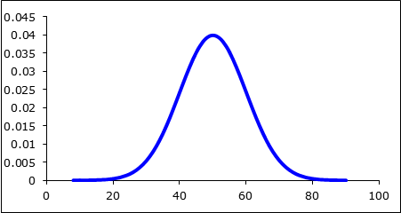
Example-setting up hypotheses
Can we conclude that a certain population mean is not 50?
What is the null hypothesis?
What is the alternative hypothesis?
Can we conclude that the population mean is less than 50?
H₀
H_{A}

Slide 36
What are we really testing?
What you hope to conclude as a result of the test usually should be placed in the alternative hypothesis
The null hypothesis should contain a statement of equality
The null hypothesis is the hypothesis that is tested
The null and alternative hypotheses are complementary
The two together exhaust all possibilities regarding the value of the parameter being tested can assume

Slide 37
What do we conclude after a hypothesis test?
Reject the null hypothesis
If we reject the null hypothesis, do we state that the alternative is true?
NO
The alternative hypothesis may be true
We determine the probability that the null hypothesis is actually true.
“There is sufficient evidence to warrant rejection of the claim that …(original claim)”

Slide 38
Conclusions of a hypothesis test
What if we find no evidence to reject the null hypothesis?
Do we say that the null hypothesis is true?
NO
We fail to reject the null hypothesis
The null hypothesis may be true
“There is not sufficient evidence to warrant rejection of the claim that ….(original claim)”

Slide 39
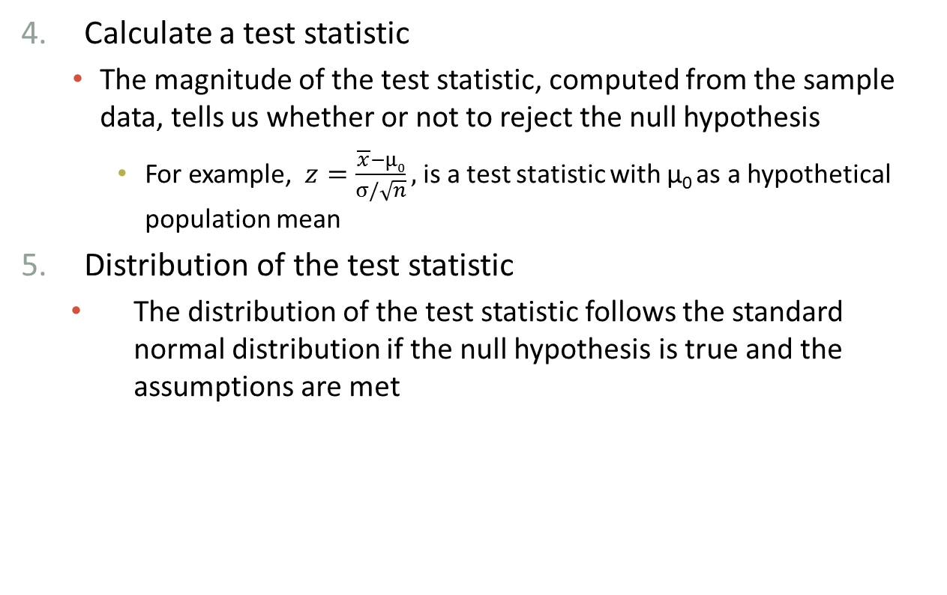
General procedure
Calculate a test statistic
The magnitude of the test statistic, computed from the sample data, tells us whether or not to reject the null hypothesis
For example, $z=\frac{\overline{x}−µ0}{σ/\sqrt{n}},$ is a test statistic with µ₀ as a hypothetical population mean
Distribution of the test statistic
The distribution of the test statistic follows the standard normal distribution if the null hypothesis is true and the assumptions are met

Slide 40
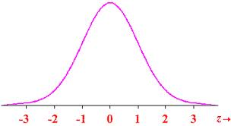
General Procedure
Decision rule
Do we reject or fail to reject the null hypothesis?
Critical region-set of all values of the test statistic that cause us to reject the null hypothesis
Significance level, α
Probability that the test statistic will fall in the critical region when the null hypothesis is actually true
Commonly used level is 0.05
Critical values
P-value
Probability associated with getting the particular sample mean (or other statistic) due to random variation

Slide 41
Two-sided and one-sided tests
In two-tailed tests, the significance level α is divided equally between the two tails that constitute the critical region
At α=0.05, there is an area of 0.025 in each of the two tails
If you are only looking for a value in one tail, if for instance you know that the value would only change in one direction, the significance level is only in one tail
Use extreme caution!
One-tailed tests are rare in practice

Slide 42
Critical values
Two-tailed tests
If z is greater than critical value, or less than the negative of the critical value, the null hypothesis is rejected
alpha | Critical value
0.20 | 1.282
0.10 | 1.645
0.05 | 1.96
0.01 | 2.576
0.001 | 3.291

Slide 43
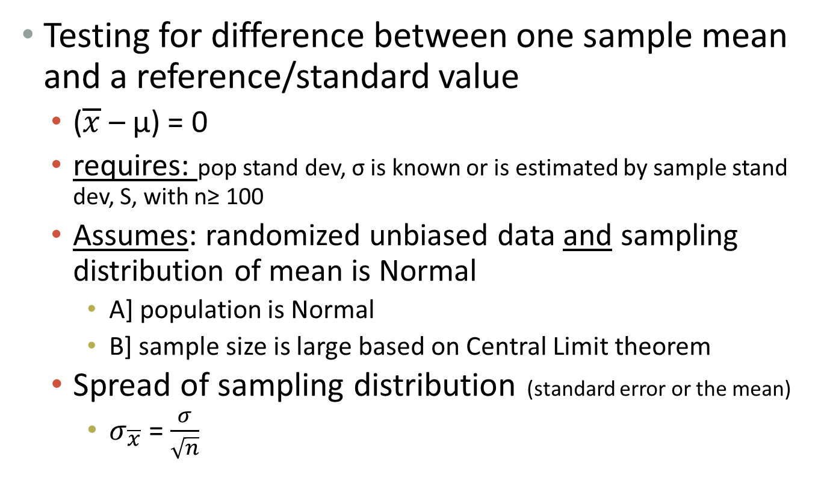
When can you use a z test
Testing for difference between one sample mean and a reference/standard value
($\overline{x}$ – μ) = 0
requires: pop stand dev, σ is known or is estimated by sample stand dev, S, with n≥ 100
Assumes: randomized unbiased data and sampling distribution of mean is Normal
A] population is Normal
B] sample size is large based on Central Limit theorem
Spread of sampling distribution (standard error or the mean)
$σ_{\overline{x}}$ = $\frac{σ}{\sqrt{n}}$

Slide 44

Z-test
Test statistic for z test
From sample data
$$z=\frac{\overline{x}−µ}{\frac{σ}{\sqrt{n}}}$$

Slide 45
Example
The National Center for Health Statistics published a report that the mean total cholesterol level for all adults was 203. A separate study on a particular subset of the population with n=3310 participants was performed, and investigators want to assess whether mean cholesterol in this group is different than the national population mean
To test the hypothesis, we use sample statistics
N=3310
X = 200.3
s= 36.8
Is there evidence that this sample has mean cholesterol levels that are different from the national population mean?

Slide 46
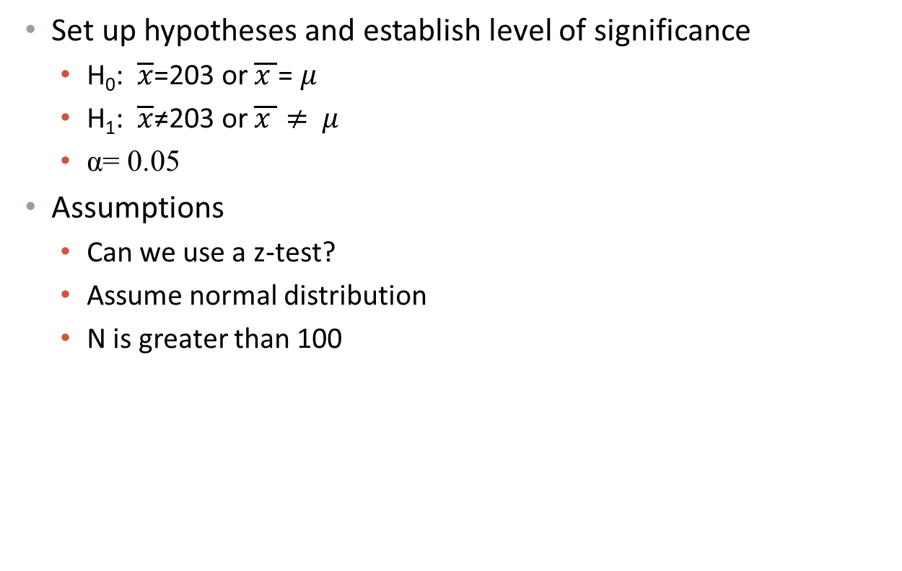
Example continued
Set up hypotheses and establish level of significance
H₀: $\overline{x}$=203 or $\overline{x }$= $μ$
H₁: $\overline{x}$≠203 or $\overline{x }≠$ $μ$
α= 0.05
Assumptions
Can we use a z-test?
Assume normal distribution
N is greater than 100

Slide 47
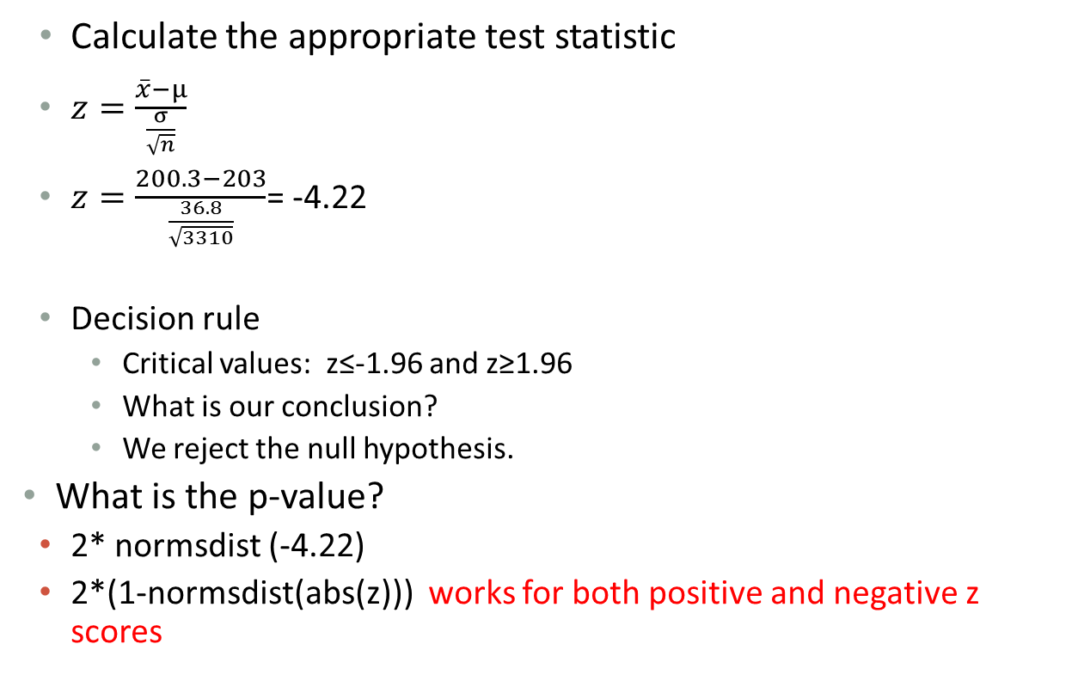
Example
Calculate the appropriate test statistic
$z=\frac{\overline{x}−µ}{\frac{σ}{\sqrt{n}}}$
$z=\frac{200.3−203}{\frac{36.8}{\sqrt{3310}}}$= -4.22
Decision rule
Critical values: z≤-1.96 and z≥1.96
What is our conclusion?
We reject the null hypothesis.
What is the p-value?
2* normsdist (-4.22)
2*(1-normsdist(abs(z))) works for both positive and negative z scores
2.44302E-05

Slide 48
Z-test and p-value
So what does p-value mean?
Ans:
Probability associated with getting the particular sample mean due to random variation

Slide 49
P-value
Question: How is p-value used to infer or interpret outcome as statistically significant?
Ans: Generally, if there is less than 5% chance of randomly selecting a sample with a given value relative to the expected value, this taken to be such an unlikely event as to strongly say there may be a difference between groups/samples or there is an effect of treatment

Slide 50
P-value rules
If p ≤ 0.05
then most BME would say this is statistically significant
If 0.05 ≤ p ≤ 0.1,
this is a grey zone; some evidence seems to suggest a possible difference, but additional testing needed and or need to increase sample size to determine if there is real significance
If p > 0.1,
then evidence is insufficient to claim significance and ANY differences observed are due simply to RANDOM SAMPLING VARIATION

Slide 51
Questions
Can the p value be negative? No
Can the p value be equal 0.0? No
Can the p value be 1.0? Not likely (treatment effect size equals the one defined by H_{o})
Should the p values be reported as fractions of percentages?
Commonly reported as fractions
Is the one tailed p value always equal half of the two tailed p value?
Not always

Slide 52
Questions
Can a one tailed p value have a value greater than 0.5?
Yes. When the direction of the treatment is opposite to the prediction
Is the p value always associated with the null hypothesis?
Yes. If one can not state the null hypothesis the p value can not be interpreted
Shouldn’t the p value always presented with conclusion about whether the results are statistically significant?
No. The p value can be interpreted on its own.
I chose to use one-tailed p value but the results came out in the direction opposite to my prediction. Can I report one tailed p value?
Probably not
Is the null hypothesis ever true? Rarely

Slide 53
Borderline statistical significance:
p value of 0.049 is statistically significant 0.051 is not
Marginally significant
Almost statistically significant
More creative versions
Clear trend
Barely missed statistical significance
Not exactly significant
Not currently significant
On the cusp of significance
Not exactly significant
Provisionally significant
Trending towards significance
Verging on significance
(468 such phrases)

